Slide 1
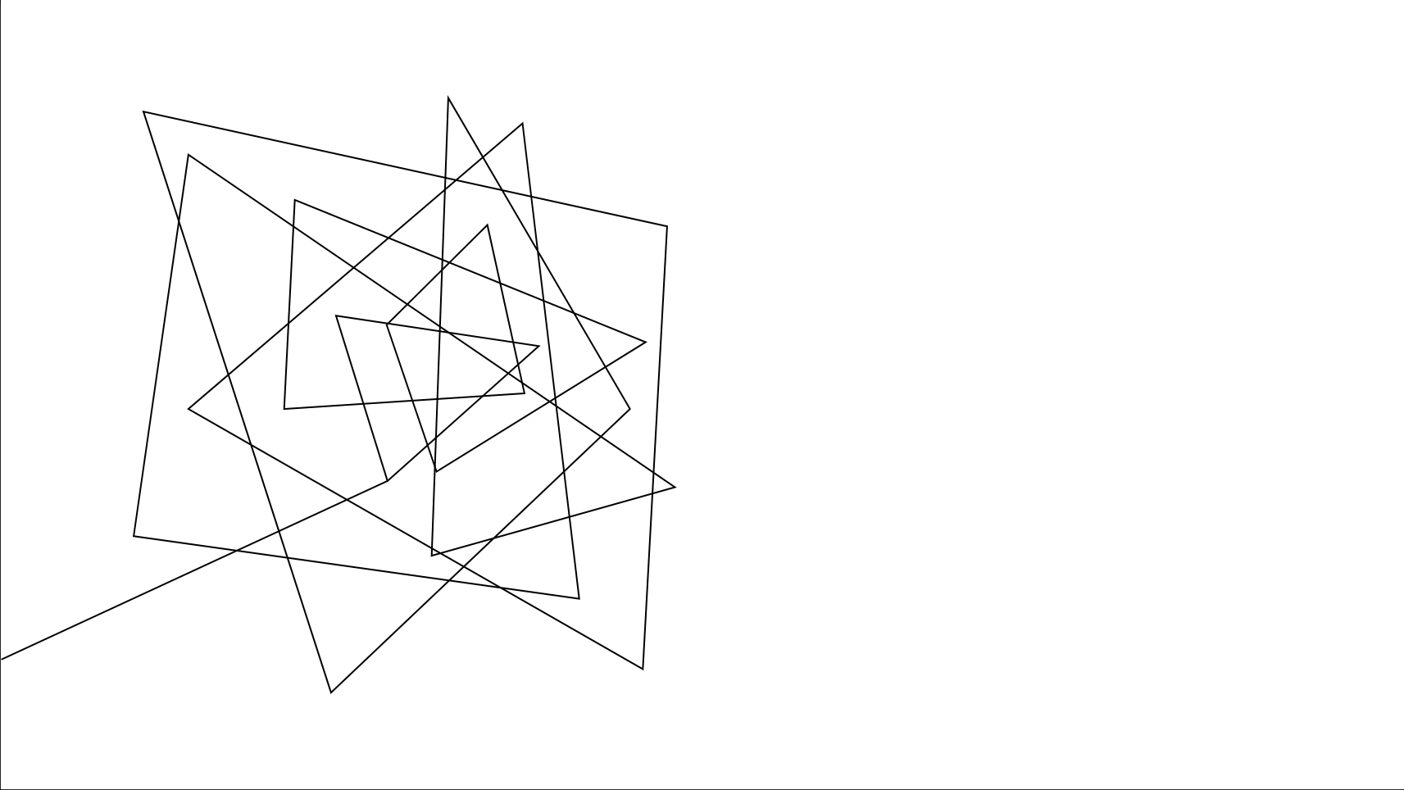
Dr. Pill
Automatic Pill Dispenser

Slide 2





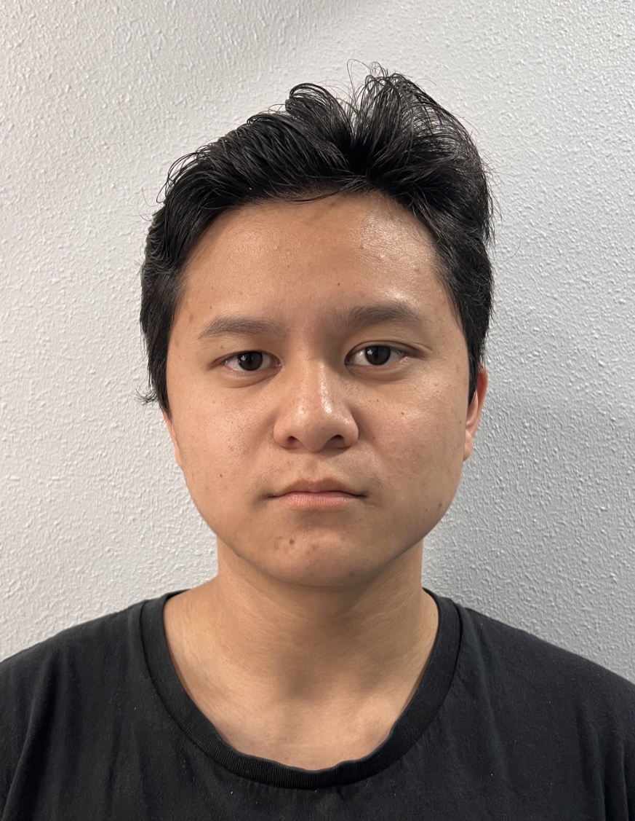
MEET THE TEAM
Jonathan Cerniaz
Jehmel
Espiritu
Jeremy Espiritu
Joseph Guzman
Afzal
Hakim
Lee Roger
Ordinario
Fingerprint and Facial Recognition
Circuit Design
Software Development of Interface
Software Development of Interface
Object Recognition
Board to Board Communication
3D Design
Fingerprint and Facial Recognition
Log tracking and Security
Pill Storage System and Organization
Soldering

Slide 3
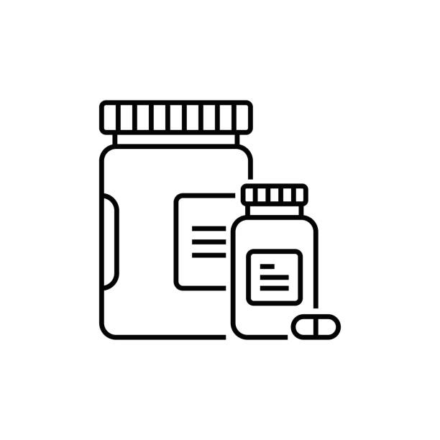
Executive Summary
Dr. Pill is an automatic pill dispenser that simplifies medication management. Our device aims to facilitate the process by freeing up more time for doctors and allowing patients to take their medication accurately by eliminating the common issue of medication errors and missed dosages.
Designated for pharmacies, nursing homes, personal households.
Dr. Pill

Slide 4
OUR 3 DEMOS
Dispense Mechanism & Storage​
2. Displaying User Interface​
3. Authentication and Board to Board Communication
Final: Completed 'Dr. Pill'
The Automatic Pill Dispenser
Dr. Pill

Slide 5
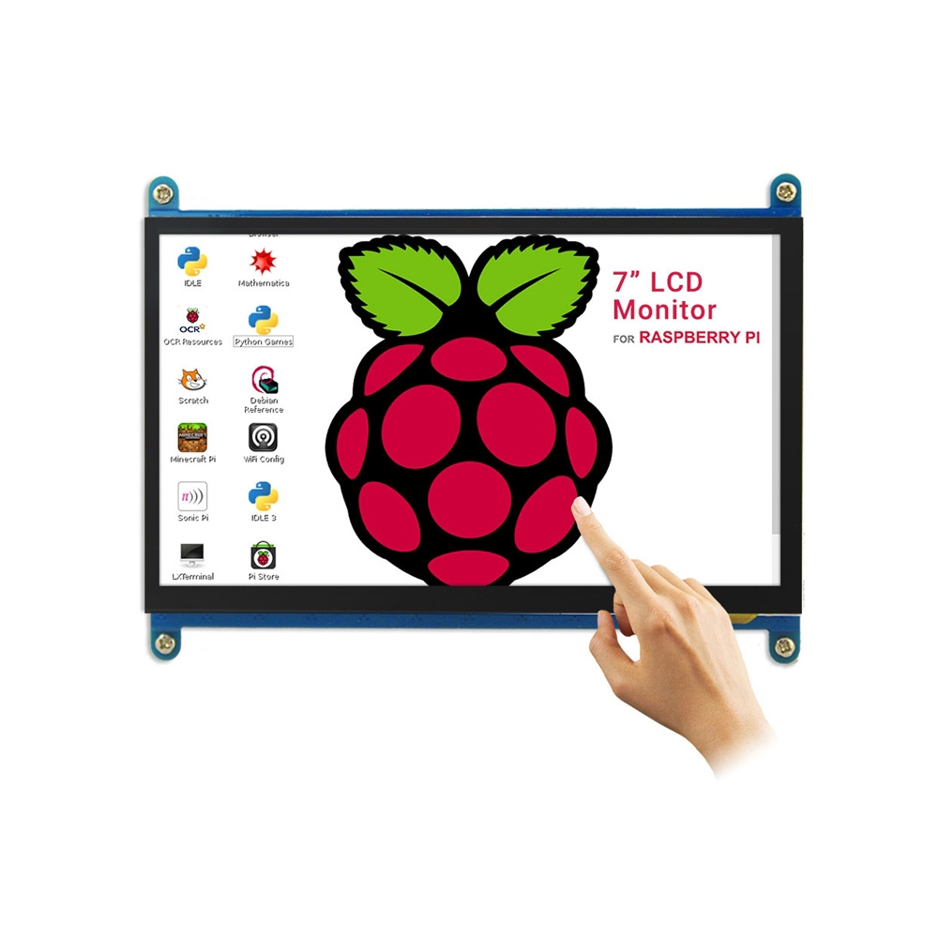
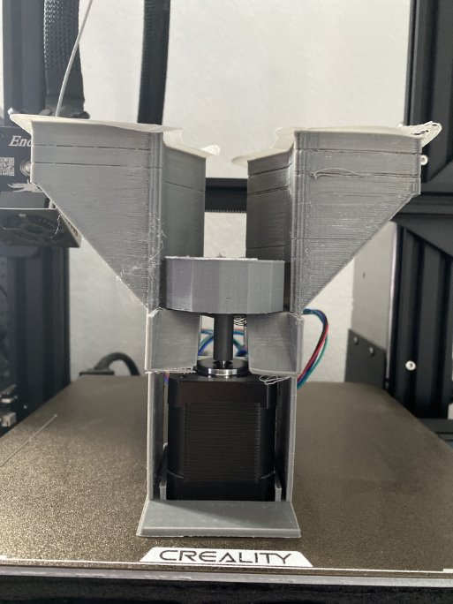
PREVIOUS demonstration
3D Design (Dispense Mechanism & Storage)
(Computer <--> MobaXTerm <--> STM32/Motors)
2. Displaying User Interface
(RaspberryPi/LCD <--> MobaXTerm <--> STM32/Motors)
Dr. Pill

Slide 6
Today's demo
Authentication and Board to Board Communication
Requirements: Fingerprint and Facial Recognition working for specified users, object detecting different pills
Constraints: Authentication devices accuracy and Motor response from GUI input
Success: Fingerprint and facial recognition sensor successfully integrated with our GUI.
Dr. Pill

Slide 7
DEMO TIME

Slide 8
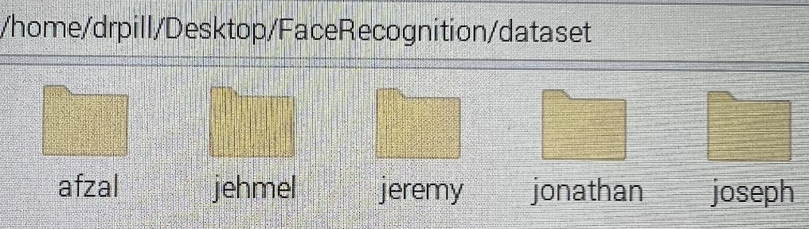
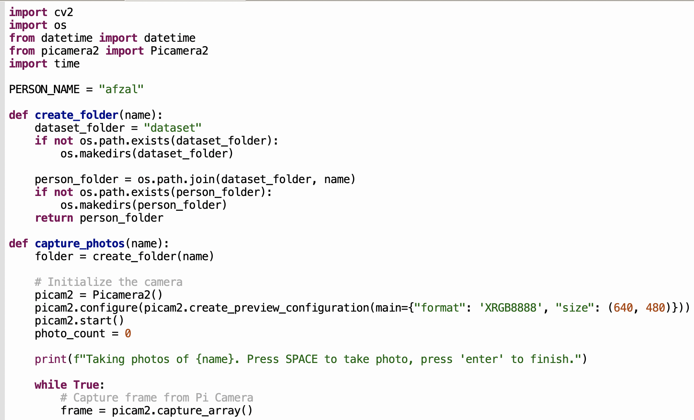

Technical details
Dr. Pill

Slide 9
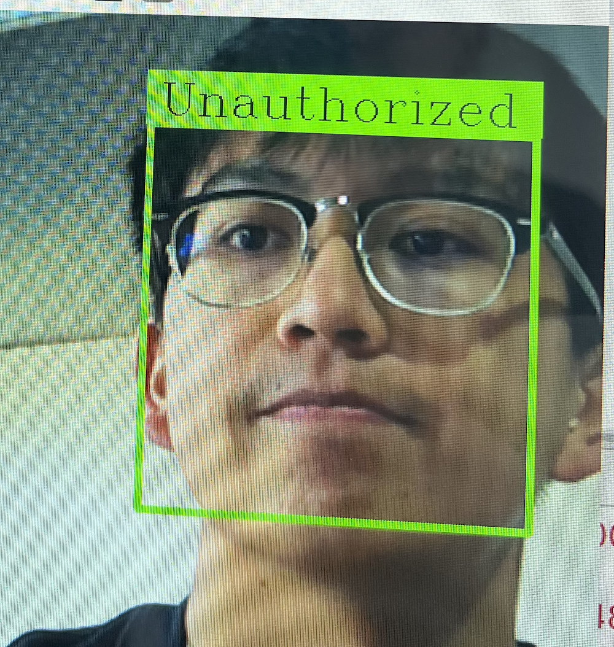
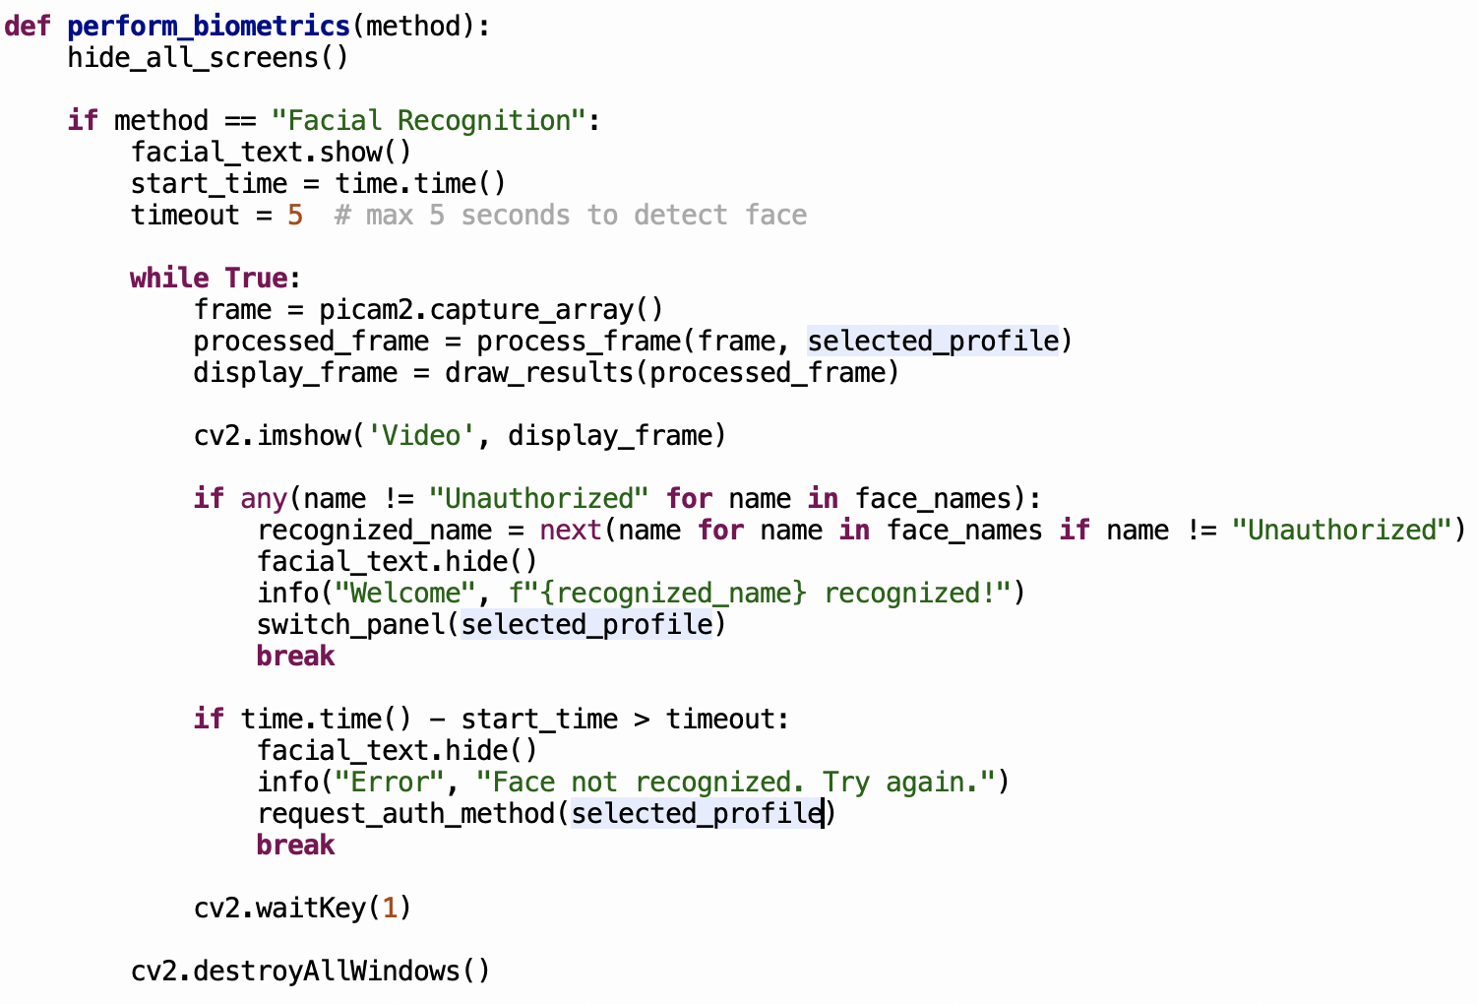
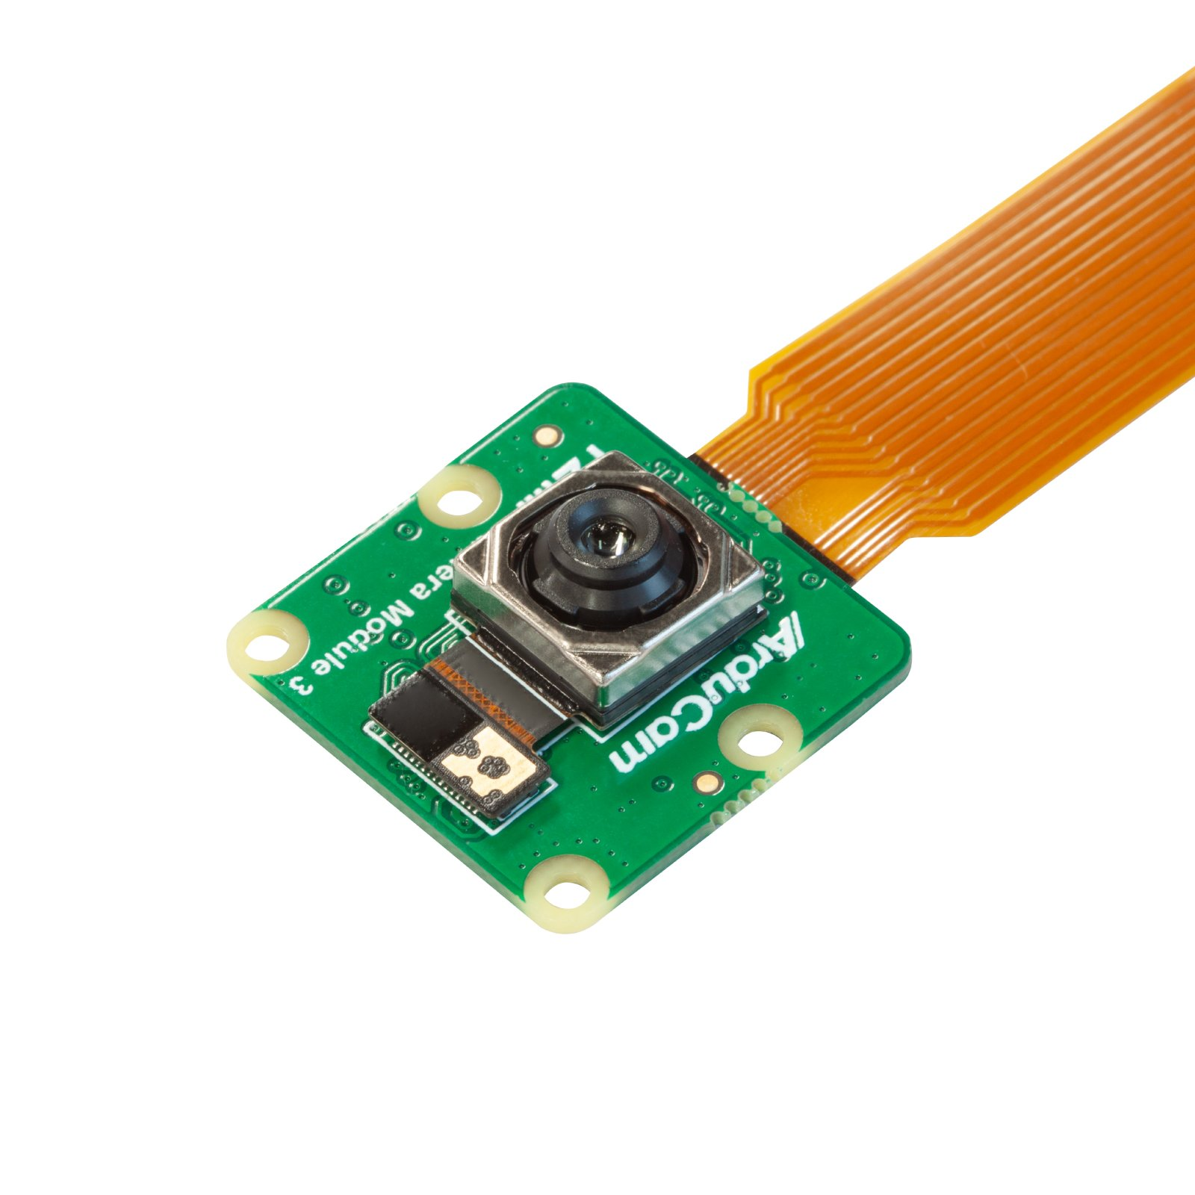
Technical details
Dr. Pill

Slide 10
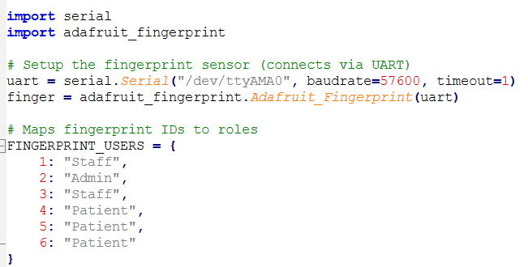
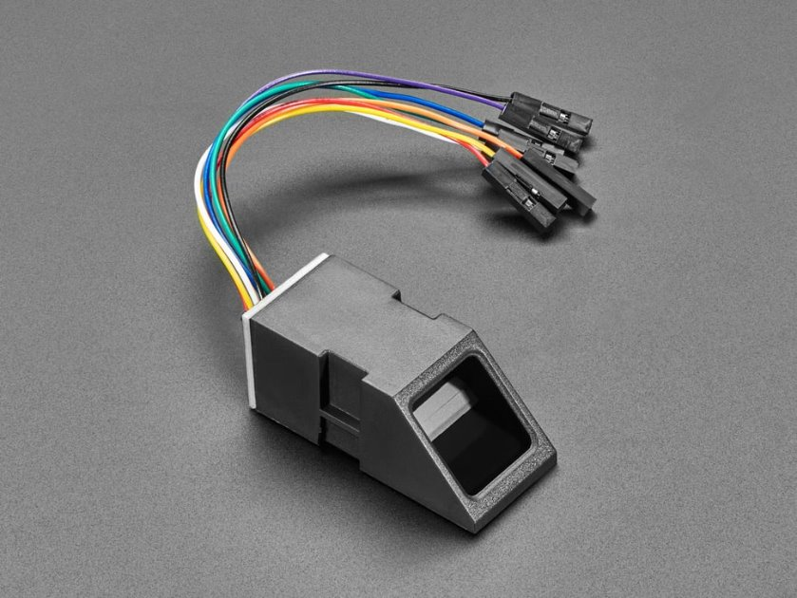
Technical details
Dr. Pill

Slide 11
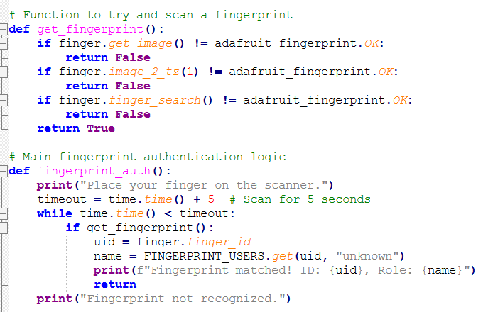
Technical details
Dr. Pill

Slide 12
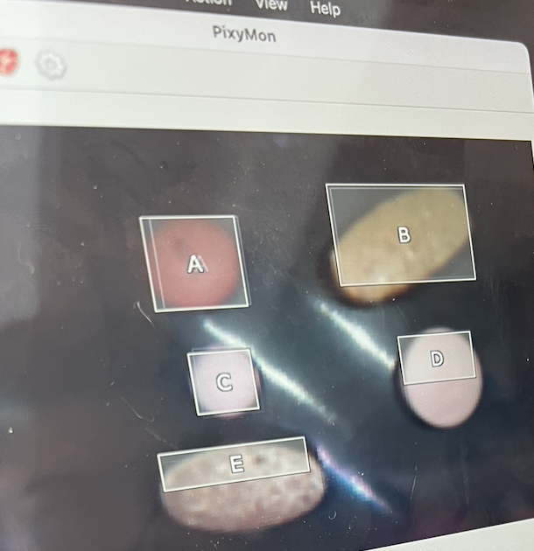
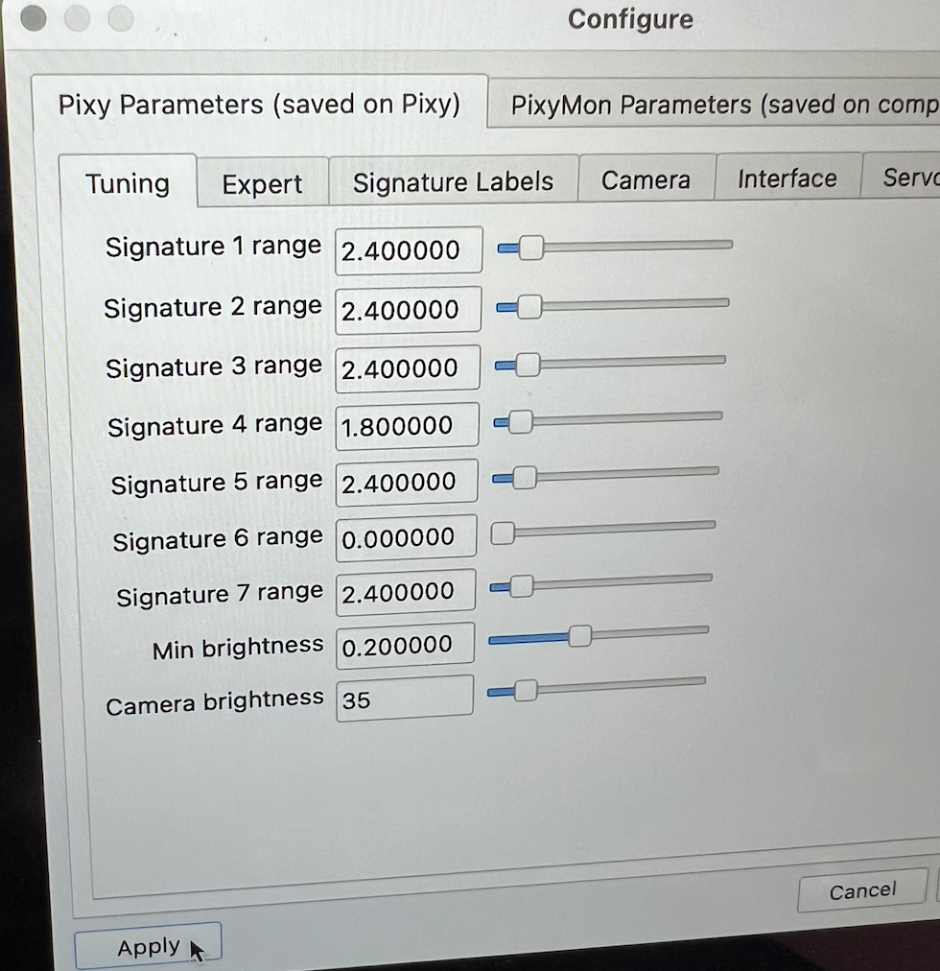
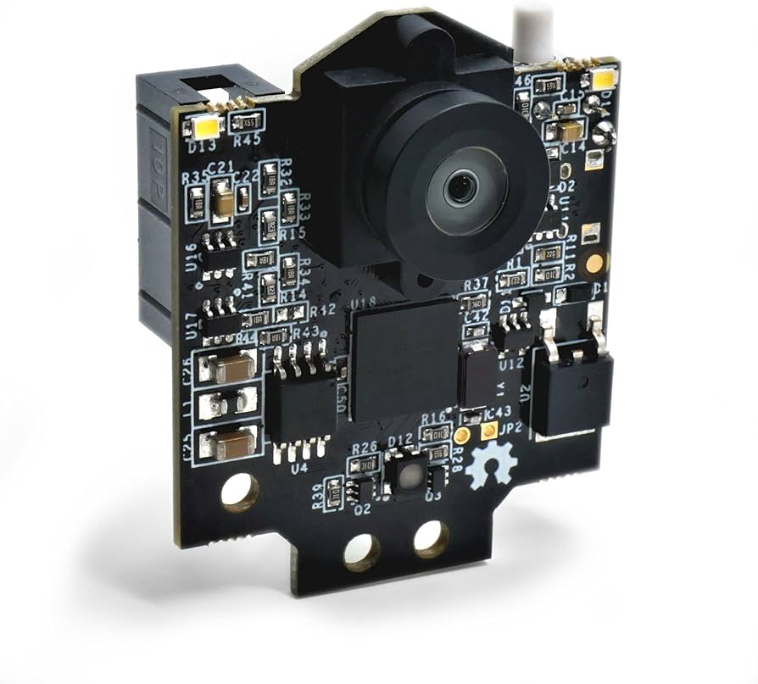
Technical details
Dr. Pill

Slide 13
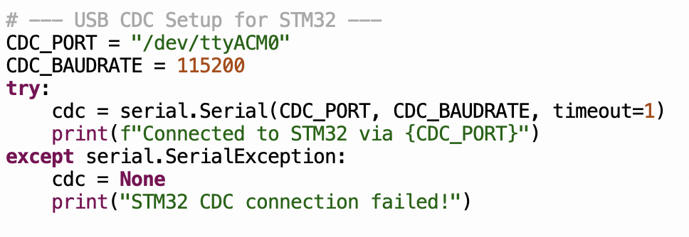
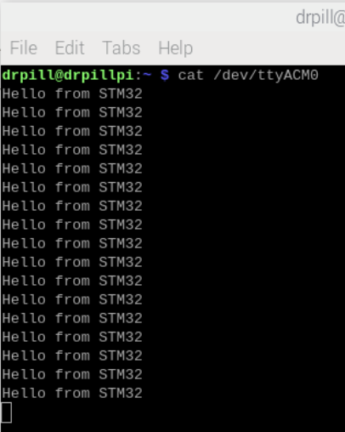
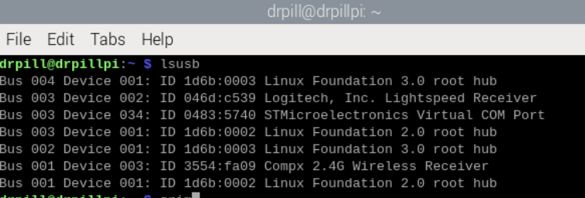
Technical details
Dr. Pill

Slide 14
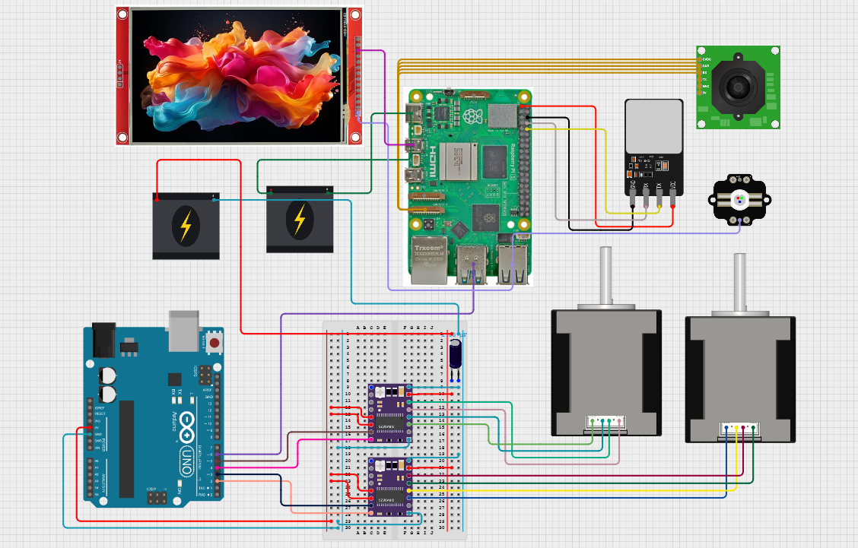
Technical details
Dr. Pill

Slide 15
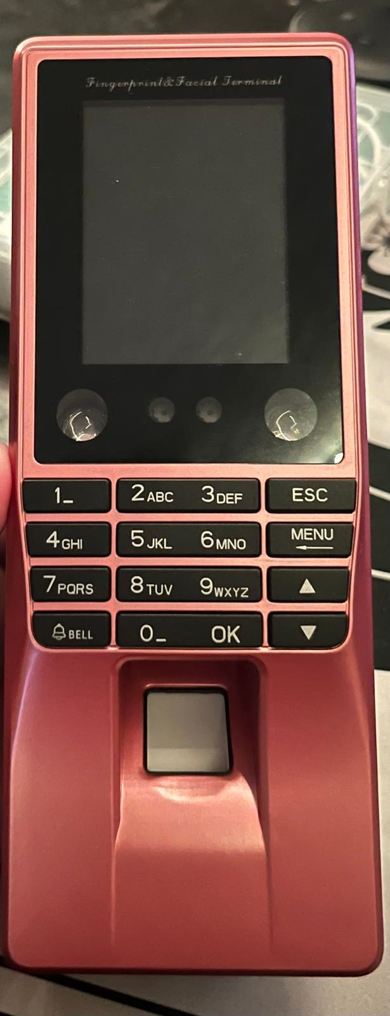
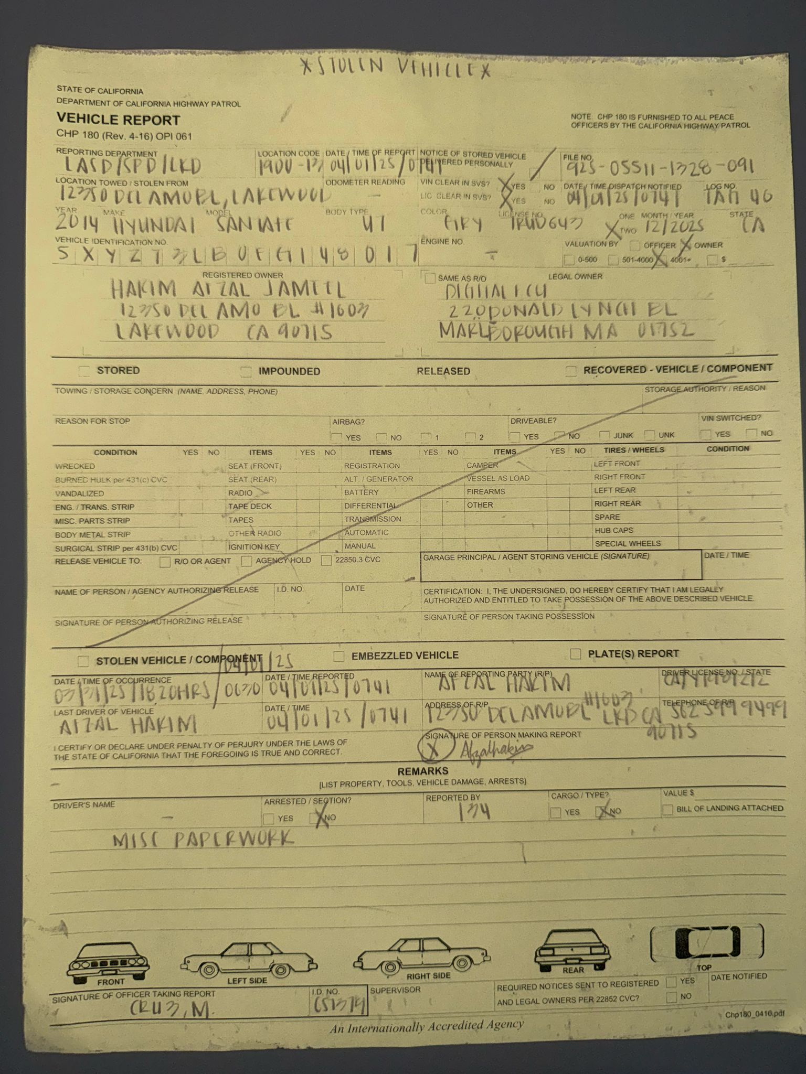
challenges
Car got stolen – This unexpected event caused us delays as our fingerprint and facial recognition device was in the car that got stolen.
New fingerprint and facial recognition devices – We switched to a new biometric device which required us to do more research and understand how to code and integrate it properly.
Challenging to code – Writing the software to integrate all hardware components, especially the new security features was complex and time consuming.
Pixy2 object recognition issue – The Pixy2 sensor detects pills based on color, so all white pills are being recognized as the same which made it hard for us to differentiate between 2 white colored pills. Lighting inconsistency obscured the camera's ability to recognize pills.
Board-to-board communication difficulties – After setting up the fingerprint and facial recognition devices separately, making them work together across different boards caused integration issues.
Dr. Pill

Slide 16
Overcoming challenges
We ended up using camera module 2 and adafruit fingerprint scanner that's connected by strip cable, and fingerprint scanner by pins and uart, since the previous device is gone
Trial and error with code and testing a number of commands in command prompt to identify the correct port for CDC setup for board to board communication
The use of different colored pills to avoid the issue of inaccuracy in identifying pills. The Pixy2 camera has a built in light that we used for the main source of lighting
Dr. Pill

Slide 17
Final demo
The complete device 'Dr. Pill' The Automatic Pill Dispenser
Log Tracking – The system keeps a record of user interactions, pill dispensing events and authentication activity.
Fully Completed GUI – A user friendly and responsive interface is ready making it easy for all users to navigate the system.
Pill Dispensing with Object Recognition – Pills are dispensed automatically with the Pixy2 sensor confirming both the number and type of pills dispensed.
All components (GUI, fingerprint, face recognition, motors, pill sensor) working together seamlessly without manual intervention.
Dr. Pill

Slide 18

Thank You
Dr. Pill

